Slide 1
Concurrent Operation of Wireless Power Transfer Based Contactless Slip Ring and Motor Drive System with a Single Converter
Enes Ayaz
M.Sc. Thesis Defense
Middle East Technical University (METU), Department of Electrical and Electronics Engineering Ankara, TURKEY
September 2022
Notes:
Dear professors and collagues

Slide 2
Outline
Aim of Study
Wireless Power Transfer System Basics
Theory Of Operations
Implementation for DC Motor
Implementation for AC Motor
Implementation for field excitation
Conclusion

Slide 3
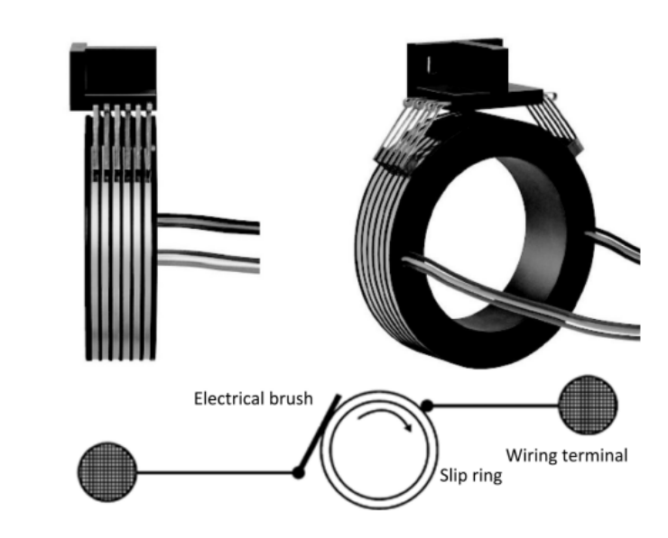
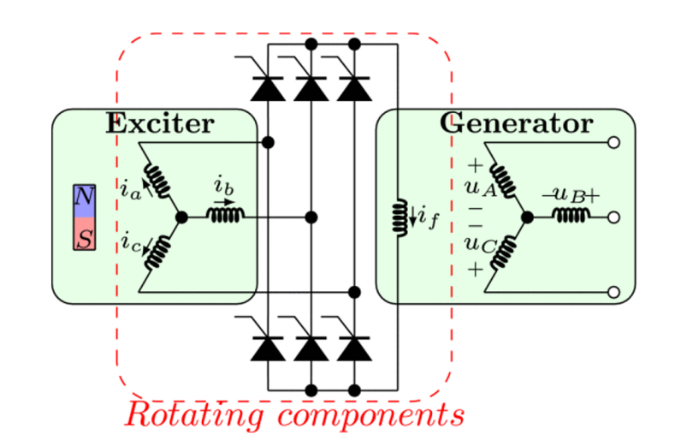
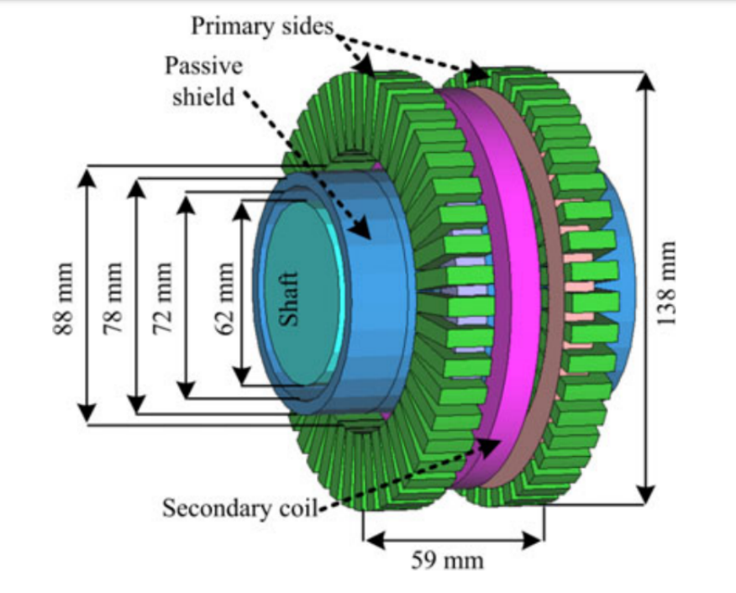
Power Transfer to Rotating Frames
Slip Rings
Brushless Exciter
Contactless
Slip Rings

Slide 4
Power Transfer to Rotating Frames
 | Slip Rings | Brushless Exciters | Contactless Slip Rings
Reliability | - | + | +
Maintenance | - | + | +
Simplicity | + | + | -
Speed Independency | + | - | +
Cost Effectivity | + | + | -
Efficiency | + | - | +

Slide 5
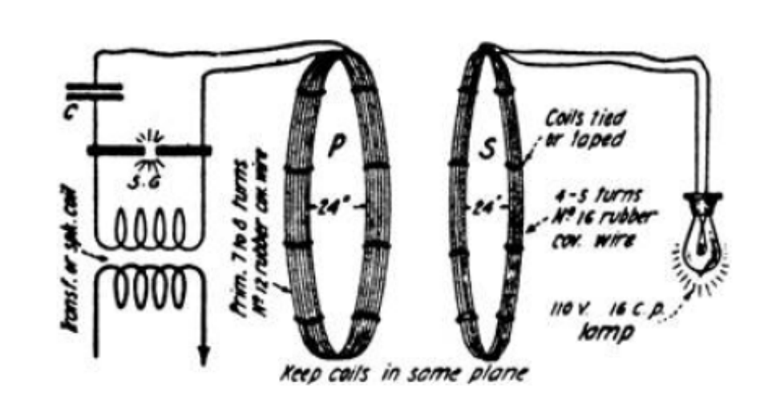
Wireless Power Transfer Based Contactless Slip Rings
 | Inductive Power Transfer | Capacitive Power Transfer
Transfer Type | Varying MF | Varying EF
Power Ratings | High | Low
Frequencies | Low | High
Efficiency | High | High
Distance | Moderate | Low
Tesla’s WPT System

Slide 6
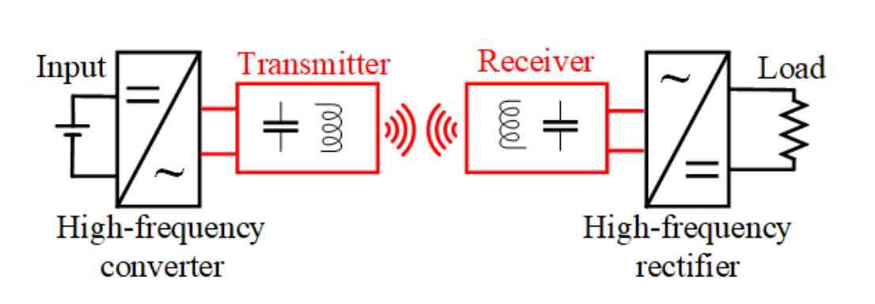
Inductive Power Transfer
DC/AC converter
Compensation Circuits
Transmitter/Receiver Coils
AC/DC Rectifiers

Slide 7
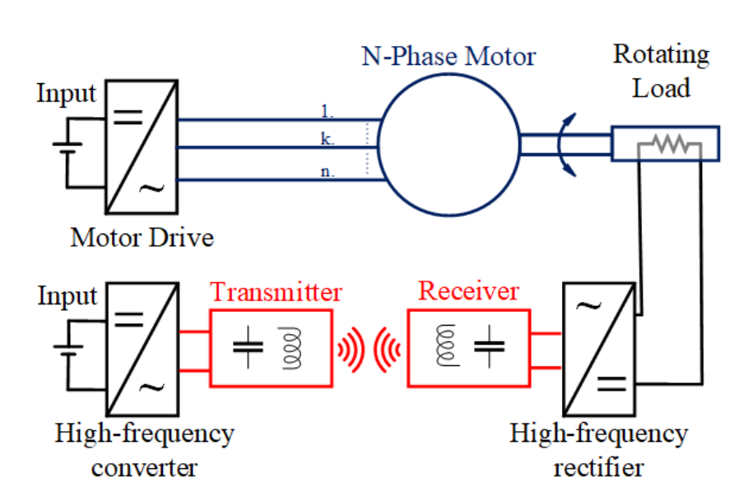
Conventional Inductive Power Transfer Based Contactless Slip Ring
Two converters:
To drive the motor
To excite the Tx coil
Motor → attenuated in motor current
The motor drive → generating low and high frequency
Motor → used to drive
The WPT converter → generating high frequency
The WPT system →behaves like band-pass filter

Slide 8
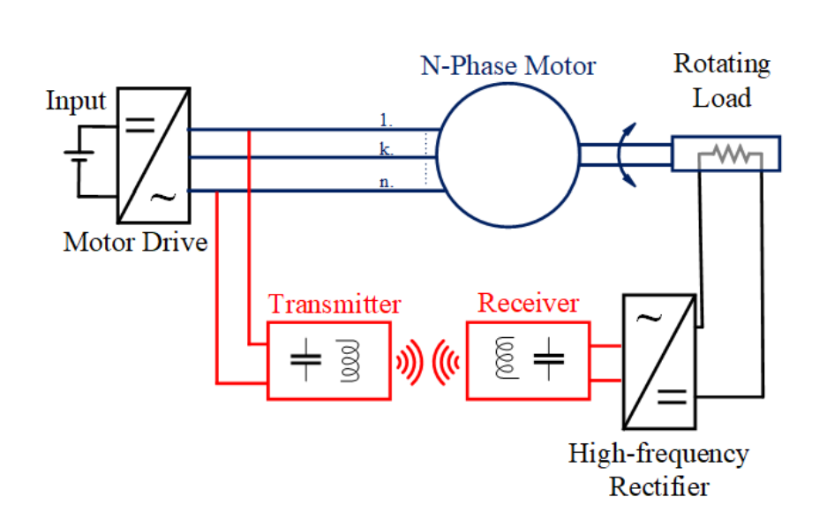
Proposed Inductive Power Transfer Based Contactless Slip Ring
The motor drive → generating high frequency
combining
The WPT system →behaves like band-pass filter
eliminating
The WPT converter → generating high frequency

Slide 9
Proposed Inductive Power Transfer Based Contactless Slip Ring
 | Conventional Contactless Slip Ring | Proposed Contactless Slip Rings
Reliability | + | +
Maintenance | + | +
Simplicity | - | +
Speed Independency | + | +
Cost Effectivity | - | +
Efficiency | + | +

Slide 10
Outline
Aim of Study
Inductive Power Transfer System Basics
Theory Of Operations
Implementation for DC Motor
Implementation for AC Motor
Implementation for field excitation
Conclusion

Slide 11
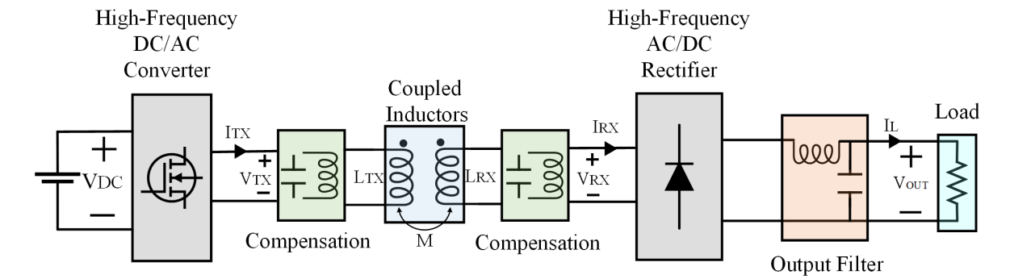
Inductive Power Transfer System

Slide 12
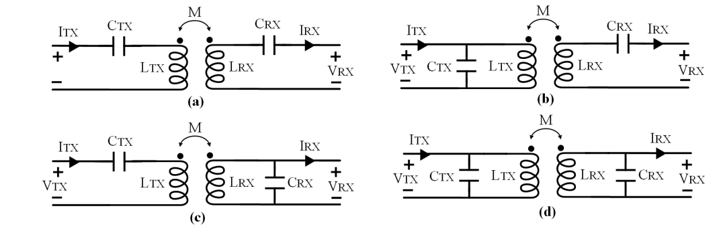
Compensation Topologies
Series-Series Compensation
Source Type | Voltage Source
Resonant frequency | Load Independent
Resonant frequency | Coupling Independent
No load operation | Short Circuit
Capacitor Size | Large
a) Series-series
b) Parallel-series
c) Series-parallel
d) Parallel-parallel

Slide 13
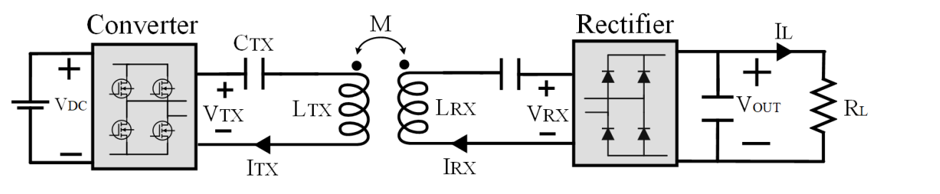
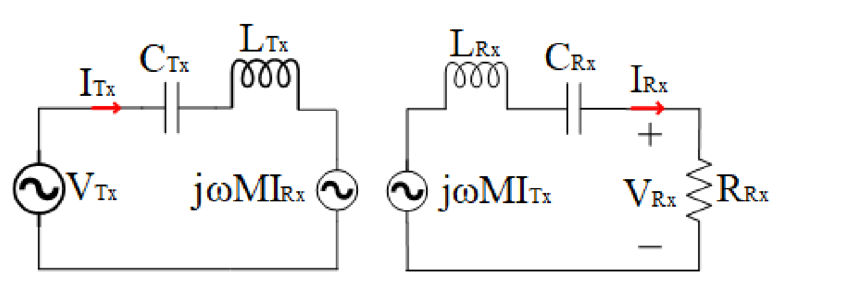
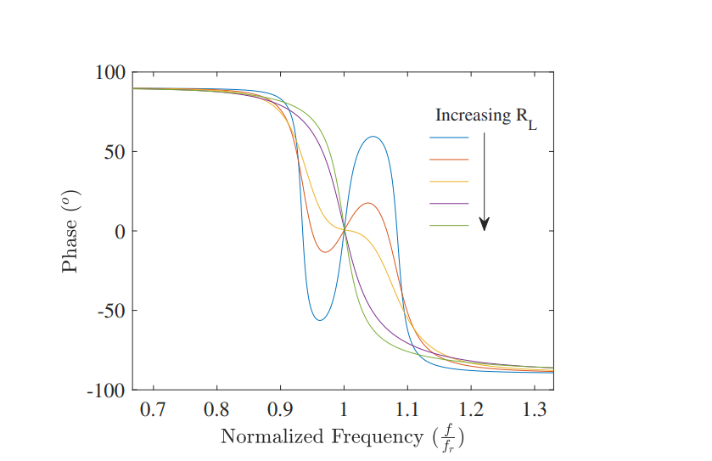
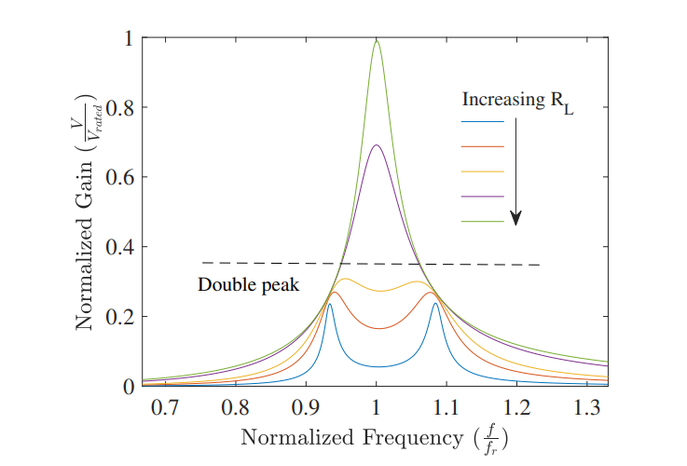
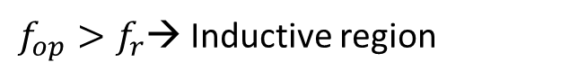
Series-Series IPT System
Single-peak band pass filter
First Harmonic Approach (FHA)
Phase < 0 → Inductive region
$f_{op}>f_{r}$→ Inductive region

Slide 14
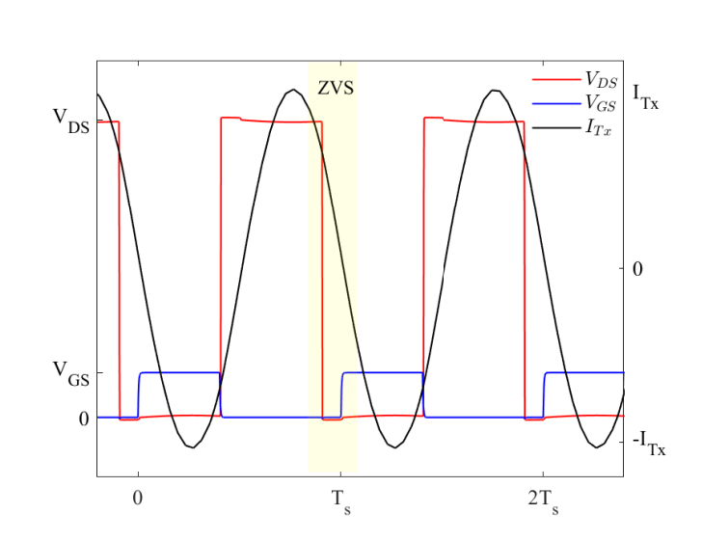
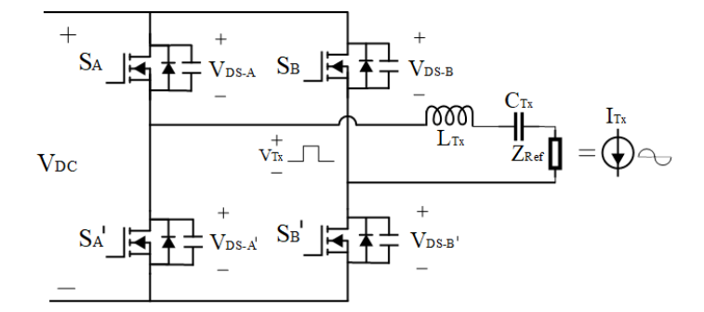
Zero Voltage Switching
Inductive region → The capacitance of the switches discharges by the load current during dead time.

Slide 15
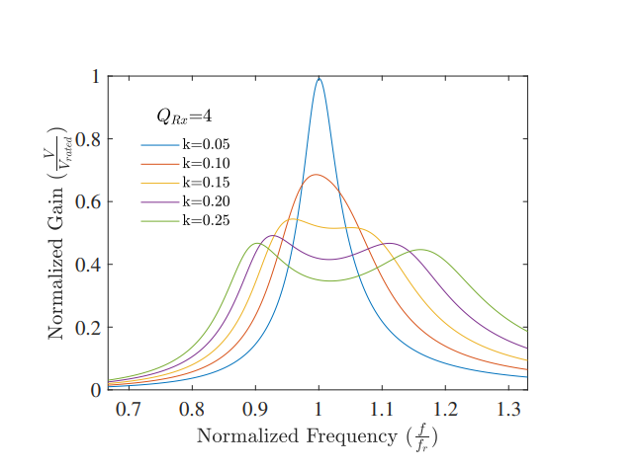
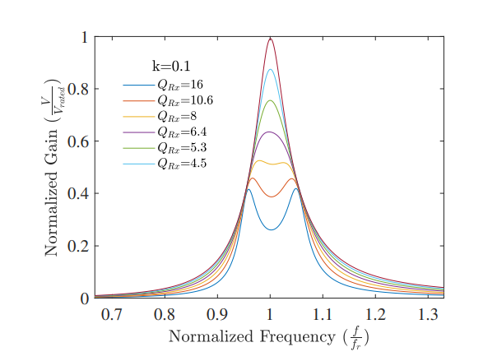
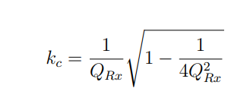
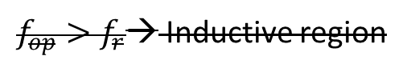
Bifurcation Phenomenon
Double-peak
$f_{op}>f_{r}$→ Inductive region
Make control difficult
Decrease efficiency

Slide 16
Multifrequency IPT Systems

Slide 17
Outline
Aim of Study
Inductive Power Transfer System Basics
Theory Of Operations
Implementation for DC Motor
Implementation for AC Motor
Implementation for field excitation
Conclusion

Slide 18
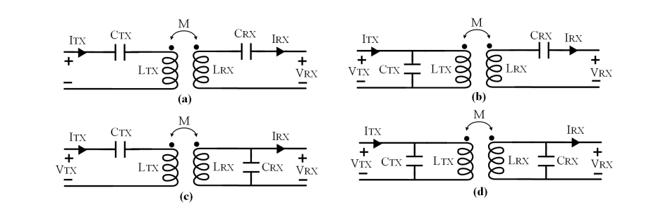
Compensation Topologies
 | Series-Series | Series-Parallel | Parallel-Parallel | Parallel-Series
Tx side Capacitor | Large | Large | Small | Small
Rx side Capacitor | Large | Small | Small | Large
No-load Operation | No | Yes | Yes | Yes
ω0 Load dependent | Independent | Dependent | Dependent | Dependent
ω0 Coupling dependent | Independent | Dependent | Dependent | Dependent
Source Type | VS | CS | CS | VS

Slide 19
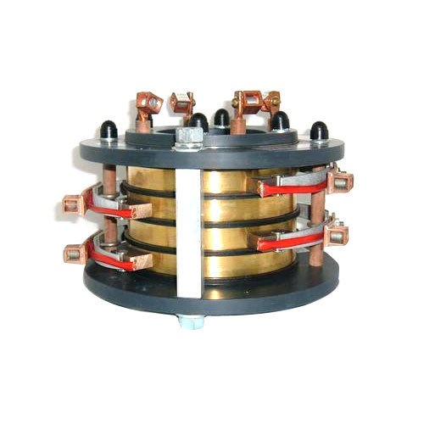
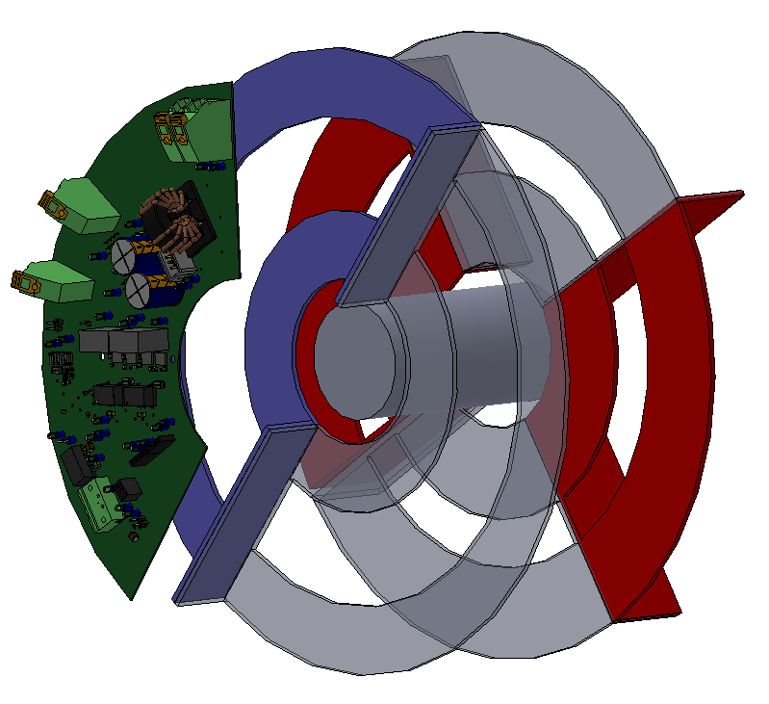
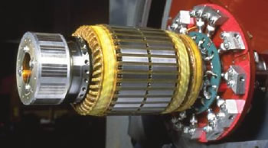
Slip Rings and Brushless Exciters
 | Slip Rings | Brushless Exciters | IPT Slip Ring
Merits | Inexpensive High electrical efficiency | No physical connection Reliable | No friction wear No speed limitation High efficiency Reliable
Challenges | Prone to failure due friction wear. Regular brush replacement Regular maintanence | Problematic at low rotational speed Expensive | Expensive Complex

Slide 20
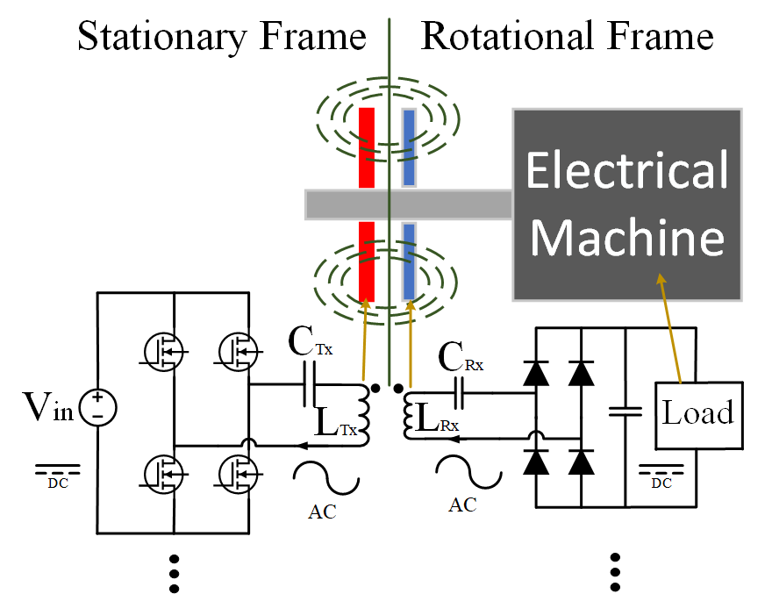
Inductive Power Transfer System Proposal
Receiver modules are connected in parallel to common DC-bus.
Modular structure is employed to increase:
Reliablity
Fault Tolerance

Slide 21
Outline
Aim of Study
Inductive Power Transfer Systems
Analytical Modeling
Experimental Verification
2Tx-4Rx IPT System with Middle Stage Resonator
Conclusion

Slide 22
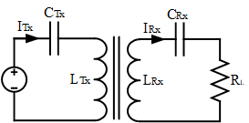
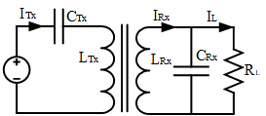
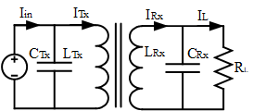
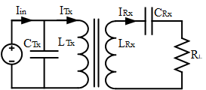
Inductive Power Transfer System Topologies
Series-Series
Series-Parallel
Parallel-Parallel
Parallel-Series
 | Series-Series | Series-Parallel | Parallel-Parallel | Parallel-Series
Tx side Capacitor | Large | Large | Small | Small
Rx side Capacitor | Large | Small | Small | Large
No-load Operation | No | Yes | Yes | Yes
ω0 Load dependent | Independent | Dependent | Dependent | Dependent
ω0 Coupling dependent | Independent | Dependent | Dependent | Dependent
Source Type | VS | CS | CS | VS

Slide 23
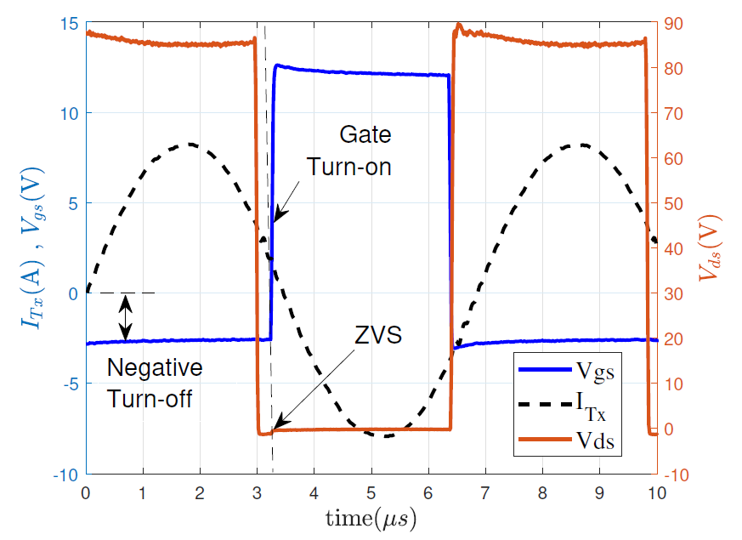
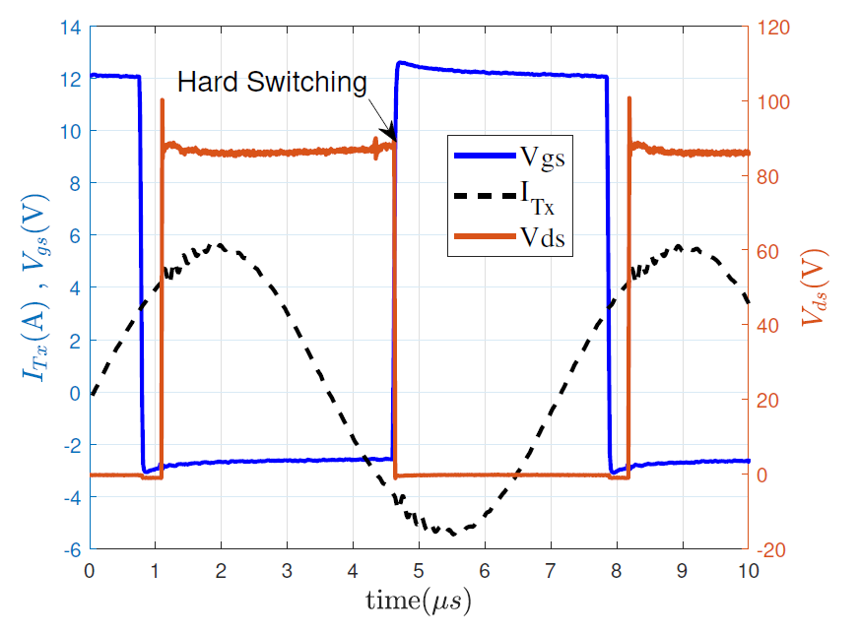
Zero Voltage Switching in IPT Systems
For ZVS operation, lagging power factor
should be achieved!
Leading power factor
Lagging power factor

Slide 24
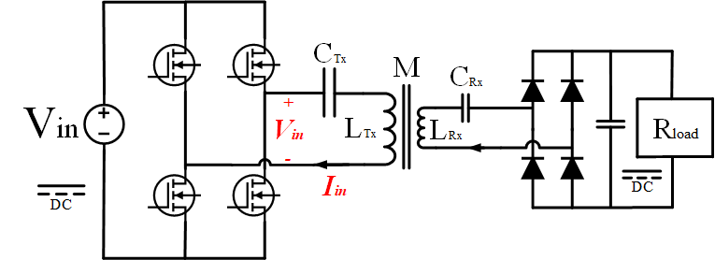
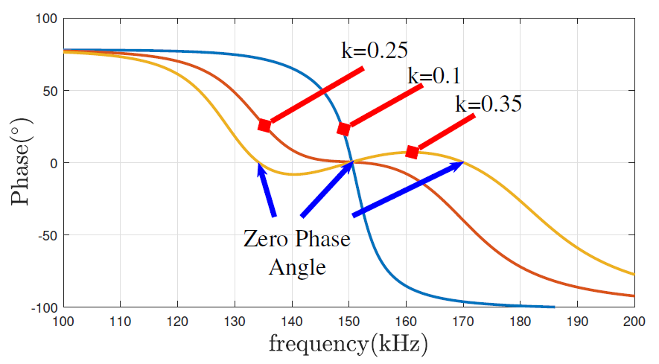
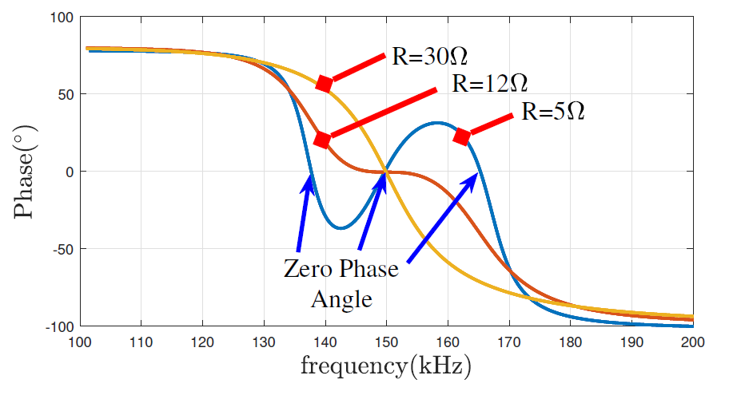
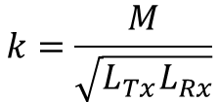
Bifurcation Phemonemon
Under bifurcation, operation above resonant frequency doesn’t guarentee ZVS operation!
$$k=\frac{M}{\sqrt{L_{Tx}L_{Rx}}}$$
Constant Rload - Variable magnetic coupling (k)
Constant magnetic coupling (k)- Variable Rload

Slide 25
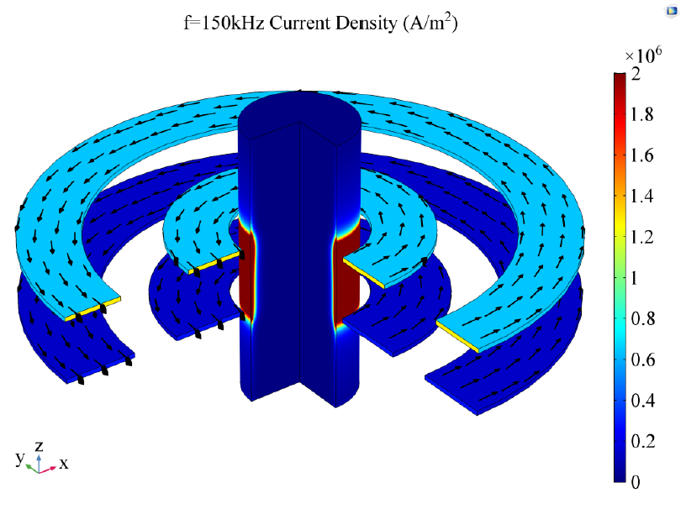
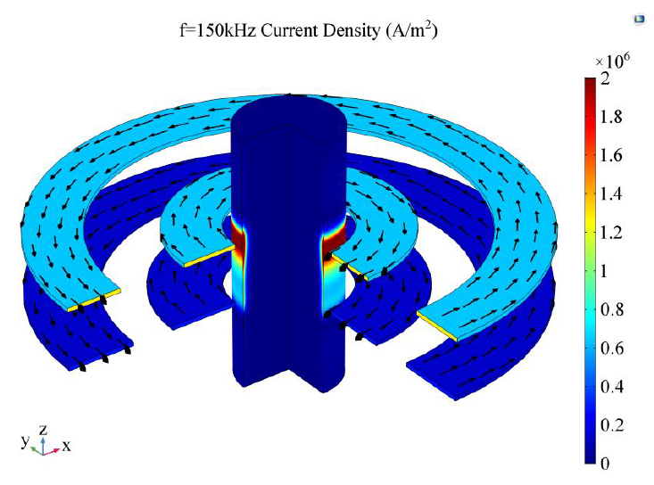
IPT Coil Shape Considerations
 | Same Direction (Circular) | Opposite Direction (Proposed)
Merits | Higher intrinsic quality factor. Easier to manufacture. | Significantly reduced Eddy losses on shaft Allows modular structures Easy mount and dismount of IPT coils
Challenges | High Eddy loss on rotating shaft. Doesn’t allow modular coil structures. | Less intrinsic quality factor. More turns for the same inductance Harder to manufacture

Slide 26
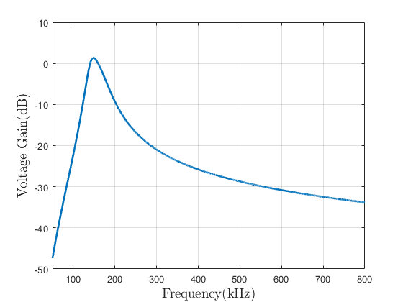
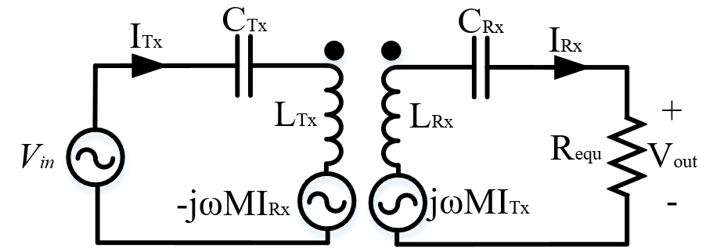
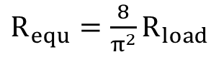
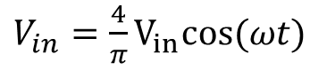
Fundamental Harmonic Approximation(FHA)
1.3 dB
$R_{equ}=\frac{8}{π^{2}}R_{load}$
-27.5 dB
$V_{in}=\frac{4}{π}V_{in}cos⁡(ωt)$
-33.5 dB

Slide 27
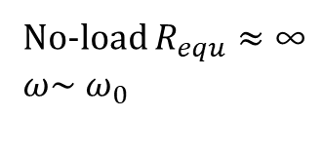
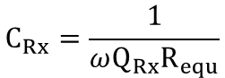
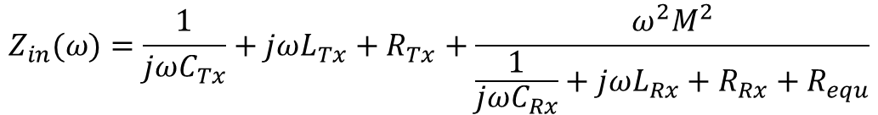

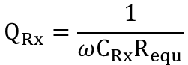
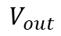
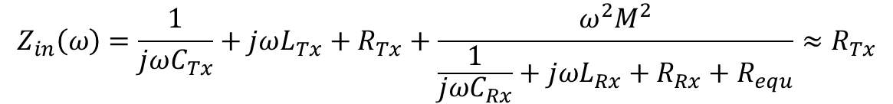
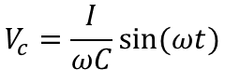
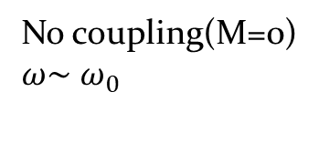
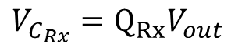




Series-Series IPT Topology
$$I_{c}=C\frac{∂V_{c}}{∂t}$$
$$V_{c}=\frac{1}{C}\int{I_{c} dt}$$
$$V_{c}=\frac{I}{ωC}sin⁡(ωt)$$
$$Q_{Rx}=\frac{1}{ωC_{Rx}R_{equ}}$$
$$C_{Rx}=\frac{1}{ωQ_{Rx}R_{equ}}$$
$$V_{c}=\frac{I_{Rx}}{\frac{ω}{ωQ_{Rx}R_{equ}}}\sin\left(ωt\right)=Q_{Rx}{ I}_{Rx}R_{equ}\sin\left(ωt\right)$$
$$V_{out}$$
$$Z_{in}(ω)=\frac{1}{jωC_{Tx}}+jωL_{Tx}+R_{Tx}+\frac{ω^{2}M^{2}}{\frac{1}{jωC_{Rx}}+jωL_{Rx}+{R_{Rx}+R}_{equ}}$$
$$V_{C_{Rx}}=Q_{Rx}V_{out}$$
No load operation is not allowed!
Zero coupling operation is not allowed!
High Q results in high voltage stress!
No coupling(M=0)
$ω\sim$ $ω_{0}$
No-load $R_{equ}≈\text{∞}$
$ω\sim$ $ω_{0}$
0
0
0
$$Z_{in}\left(ω\right)=\frac{1}{jωC_{Tx}}+jωL_{Tx}+R_{Tx}≈R_{Tx}$$
$$Z_{in}\left(ω\right)=\frac{1}{jωC_{Tx}}+jωL_{Tx}+R_{Tx}+\frac{ω^{2}M^{2}}{\frac{1}{jωC_{Rx}}+jωL_{Rx}+{R_{Rx}+R}_{equ}}≈R_{Tx}$$
$$\text{∞}$$

Slide 28
Outline
Aim of Study
Inductive Power Transfer Systems
Analytical Modeling
Experimental Verification
2Tx-4Rx IPT System with Middle Stage Resonator
Conclusion

Slide 29




Module Number Selection
 | 1Tx-1Rx | 1Tx-2Rx | 3Tx-3Rx | 2Tx-4Rx
Merits | Simple Constant coupling Constant Tx current | Constant coupling Constant Tx current Scalable | Allows 3-Φ systems Less semiconductor Higher control options | Same Tx currents Single Tx module operation Single Rx fault tolerant Scalable
Challenges | No load operation Fault tolerance | Tx module faults Current/power unbalance | Complex control | Complex Current/power unbalance Highest copper loss

Slide 30










Analytical Design
Parameters | Value
$$P_{in}$$ | 550 W
$$P_{out}$$ | 500 W
$$f_{resonant}$$ | 150 kHz
$$V_{in,DC}$$ | 100 V
$$V_{in,rms}$$ | 90$V_{rms}$
$$V_{out}$$ | 100 V
$$R_{L}$$ | 10 Ω
$$R_{equ}$$ | 16.21 Ω
$$L_{Rx}$$ | 68.8 μH
$$M$$ | 15 μH
$$L_{Tx}$$ | 82 μH
$$C_{Tx}$$ | 13.8 nF
$$C_{Rx}$$ | Calculated later!
$$Choose$$
$$Q_{Rx} of each Rx module=2$$
90% efficiency
$$k_{c}=\frac{1}{Q_{Rx}\sqrt{2}}\sqrt{1−\frac{1}{Q_{Rx}^{2}}}=0.33$$
$$V_{in,rms}=\sqrt{2}\frac{4}{π}V_{in,DC}$$
$$Choose k=0.2<0.33$$
$$R_{L}=\frac{V_{out}^{2}}{P_{out}}$$
$$R_{equ}=2\frac{8}{π^{2}}R_{L}$$
$$L_{Rx}=Q_{Rx}\frac{R_{equ}}{ω_{0}}$$

Slide 31





Current Balancing in Parallel Connected Common DC-Bus IPT Systems
Simulation results for equal magnetic coupling.($M_{1}=M_{2}$)
Simulation results for unequal magnetic coupling.($M_{1}≠M_{2}$)
Phasor representation of equal(left) and unequal(right) coupling cases.

Slide 32




Current Balancing Using Additional Cross-coupling
Simulation results for unequal coupling ($M_{1}≠M_{2}$)
without cross-coupling${ (M}_{s}=0).$
Simulation results for unequal coupling ($M_{1}≠M_{2}$)
with cross-coupling${ (M}_{s}=11 μH).$

Slide 33




Current Balancing Using Additional Cross-Coupling
Mutual difference is given as 5%.
$$CBR\left(\%\right)=100(1−\frac{|I_{Rx,1}−I_{Rx,2}|}{I_{total}})$$
$$I_{pf}=\frac{V_{out}(I_{Rx,1}+I_{Rx,2})}{V_{in}}$$
Input |  | Output
$$M_{1}$$ | 14.71$μH$ | $$α$$ | 76.7°
$$M_{2}$$ | 13.9$7 μH$ | $$β$$ | 110.8°
$$I_{Rx,1}$$ | 4.1 A | θ | 19.5°
$$I_{Rx,2}$$ | 2.8 A | $$M_{s}$$ | 11.02 $μH$
$$M_{s}=\frac{V_{out}\sin\left(β\right)−ωM_{2}I_{pf}}{ωI_{Rx,1}cos⁡(90+α)}$$

Slide 34







Current Balancing Using Rx Module De-tuning
Simulation results for unequal coupling ($M_{1}≠M_{2}$)
without Rx module resonant frequency detuning($ω_{Rx}=ω_{0}$)
Simulation results for unequal coupling ($M_{1}≠M_{2}$)
with Rx module resonant frequency detuning($ω_{Rx}≠ω_{0}$)

Slide 35



Summary of Current Balancing Methods
Parameters | Value
$$P_{in}$$ | 550 W
$$P_{out}$$ | 500 W
$$f_{resonant}$$ | 150 kHz
$$V_{in,DC}$$ | 100 V
$$V_{in,rms}$$ | 90$V_{rms}$
$$V_{out}$$ | 100 V
$$R_{L}$$ | 10 Ω
$$R_{equ}$$ | 16.21 Ω
$$L_{Rx}$$ | 68.8 μH
$$M$$ | 15 μH
$$L_{Tx}$$ | 82 μH
$$C_{Tx}$$ | 13.8 nF
$C_{Rx }$(135 kHz) | 21 nF
$$M_{s}$$ | 11 μH

Slide 36
Outline
Aim of Study
Inductive Power Transfer Systems
Analytical Modeling
Experimental Verification
2Tx-4Rx IPT System with Middle Stage Resonator
Conclusion

Slide 37






Transmitter Side IPT Coil Design

Slide 38


Receiver Side IPT Coil Design

Slide 39


Ferrite Mass Reduction
 | Ferrite Back-core | Ferrite Spoke
Inductance | 80.9 μH | 65.4 μH | 20% Decrease
Ferrite Area | 669$cm^{2}$ | 207$cm^{2}$ | 69% Decrease

Slide 40



Slide 41



IPT Coil Finite Element Analysis
5% diffence
Remember current balancing analysis?

Slide 42


Full Bridge Rectifier Modules

Slide 43


Full Bridge Converter Design

Slide 44


Full Bridge Converter Design-Additional Features

Slide 45


Full Bridge Converter Design- Thermal Design

Slide 46


Experimental Setup

Slide 47


Current Balancing Experimental Results

Slide 48


Rotational Experimental Results (Normal Operation)

Slide 49




Rotational Experimental Results
(Single Rx-Open Fault Operation)

Slide 50


Additional Experimental Results

Slide 51
Outline
Aim of Study
Inductive Power Transfer Systems
Analytical Modeling
Experimental Verification
2Tx-4Rx IPT System with Middle Stage Resonator
Conclusion

Slide 52

2Tx-4Rx IPT System with Middle Stage Resonator

Slide 53







Analytical Design

Slide 54



2Tx-4Rx IPT System with Middle Stage Resonator

Slide 55






2Tx-4Rx IPT System with Middle Stage Resonator
Normal Operation
Single Rx Open Circuit
Fault
Double Rx Open Circuit
Fault

Slide 56





2Tx-4Rx IPT System with Middle Stage Resonator
Single Tx Open Circuit
Fault

Slide 57



2Tx-4Rx Rotational IPT System with Middle Stage Resonator

Slide 58


2Tx-4Rx Rotational IPT System with Middle Stage Resonator

Slide 59


2Tx-4Rx Rotational IPT System with Middle Stage Resonator

Slide 60


2Tx-4Rx Rotational IPT System with Middle Stage Resonator

Slide 61
Outline
Aim of Study
Inductive Power Transfer Systems
Analytical Modeling
Experimental Verification
2Tx-4Rx IPT System with Middle Stage Resonator
Conclusion

Slide 62

Comparison

Slide 63

Contribution to Literature and Novelties

Slide 64
Thanks!

